Slide 1

Coronavirus Over The World
Dennis Karpunov
Tomer Cohen
Link To GitHub

Slide 2


Slide 3

Can we predict which TOP 3 countries will have the largest number of
Deaths there be with the number of population ?

Slide 4

Data Sources

Slide 5
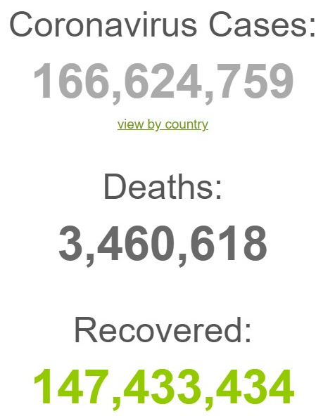


Crawling :
WORLDOMETER
WIKIPEDIA

Slide 6

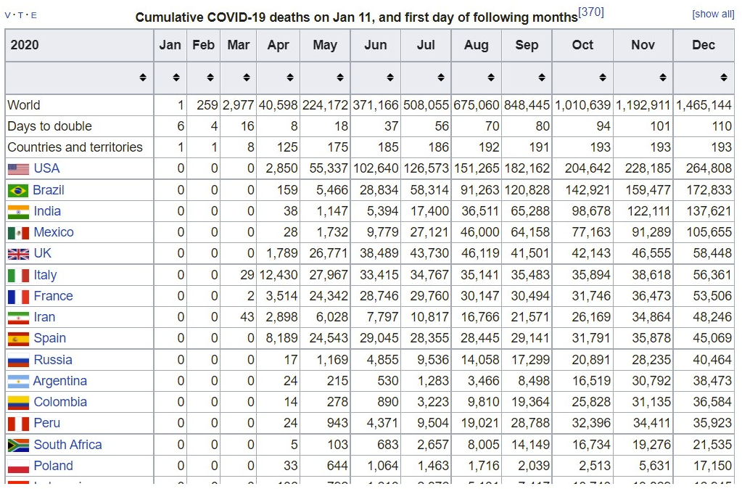
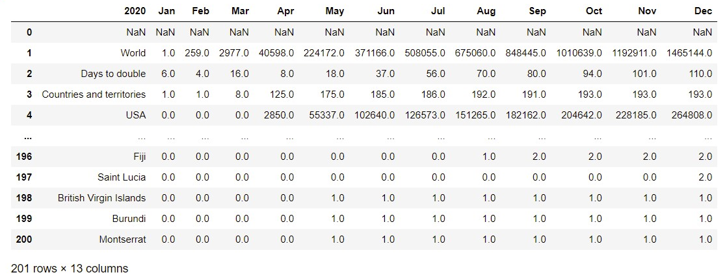
Wikipedia :
We used a bult-in functions to crawl the relevant table from the site.
With this table we can check the data and answer our research question.
we took some tables from Wikipedia and merge between them

Slide 7
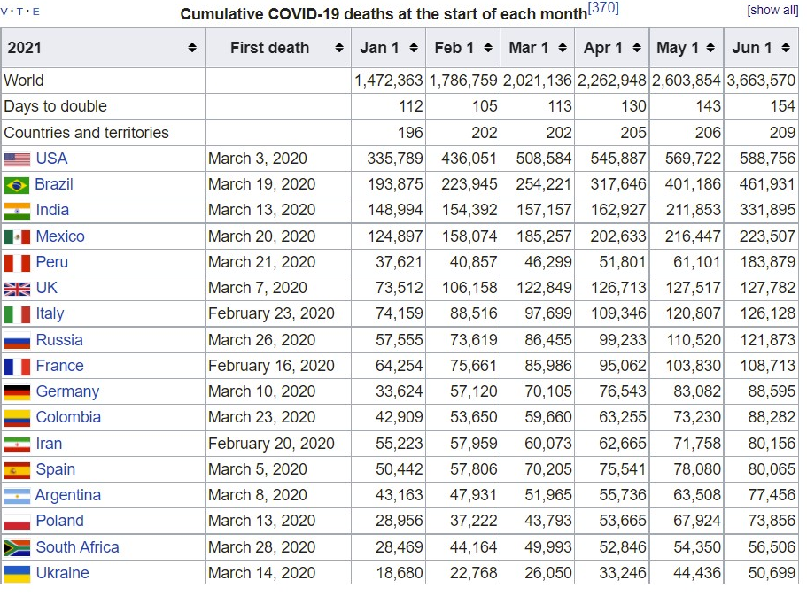
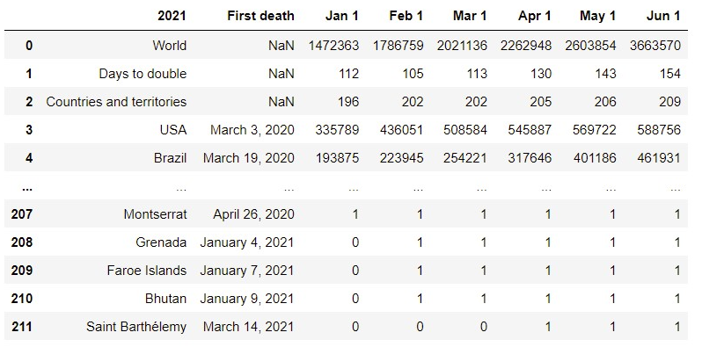
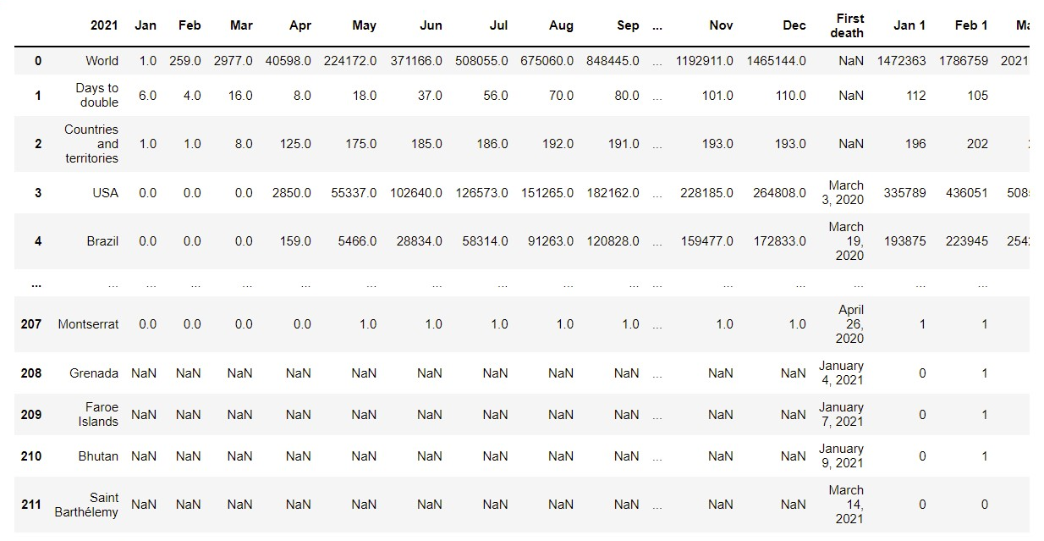

The merge table

Slide 8
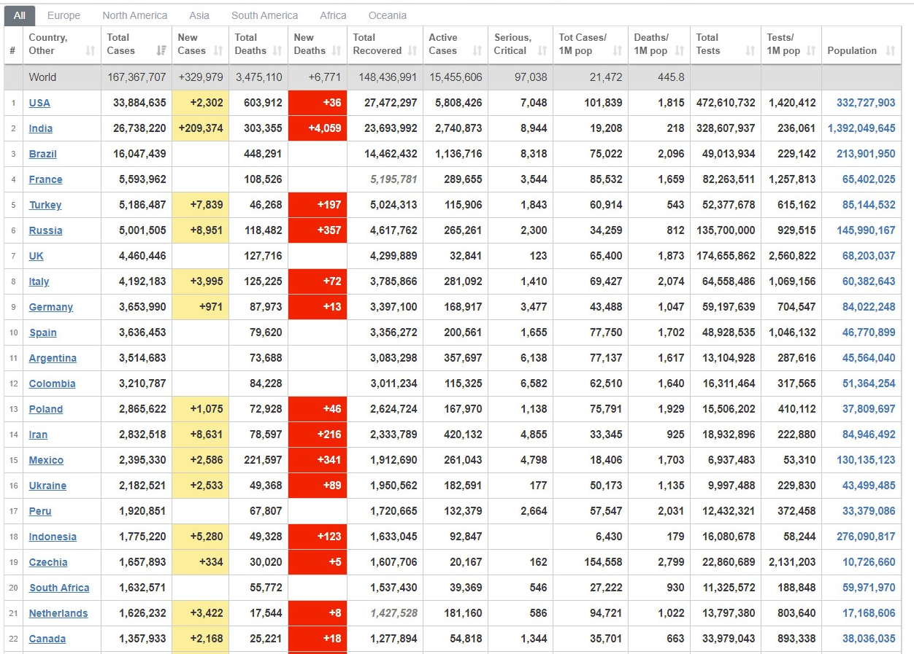
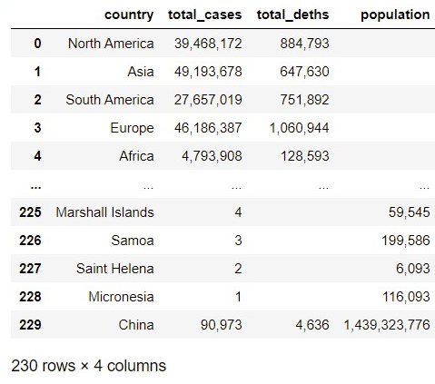
WORLDOMETER :
We used a bult-in functions to crawl the relevant table from the site.
We take specific columns from the table in the site of WORLDOMETER we
can check the data and answer our research question.

Slide 9


Slide 10

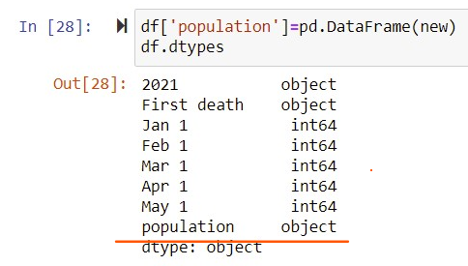
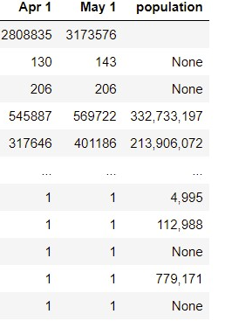
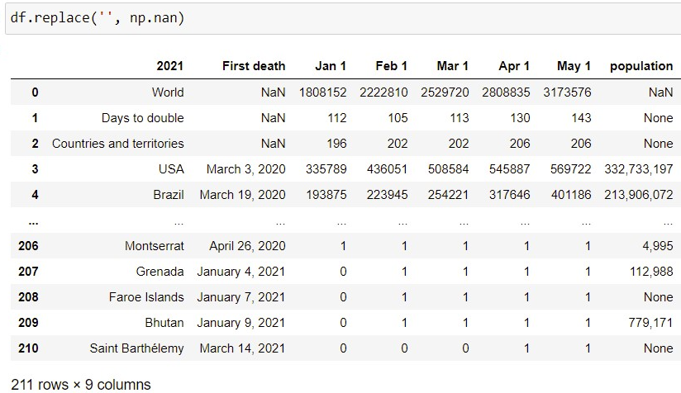
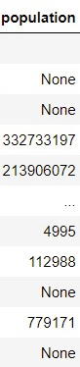
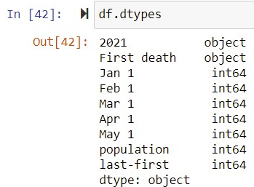
Data Cleaning :
We had a lot of problems with the tables. We want to take the column from WORLDOMETER and put
it to the merge table that we took from WIKIPEDIA,
But we had to put the correct values per country names.
We try to check our goal and do some math operations but we had a lot of ERORRS.
The columns from the site of WORLDOMETER where strings,
By the command that we learned we checked this – dataframe.dtypes
The columns are int and our is string so we cant do math operations try to change this,
But we had another problems, the column of ‘POPULATION’ had
“NONE” and blank values and the numbers where in string and had the char ‘ , ‘ between the numbers
So we change it

Slide 11
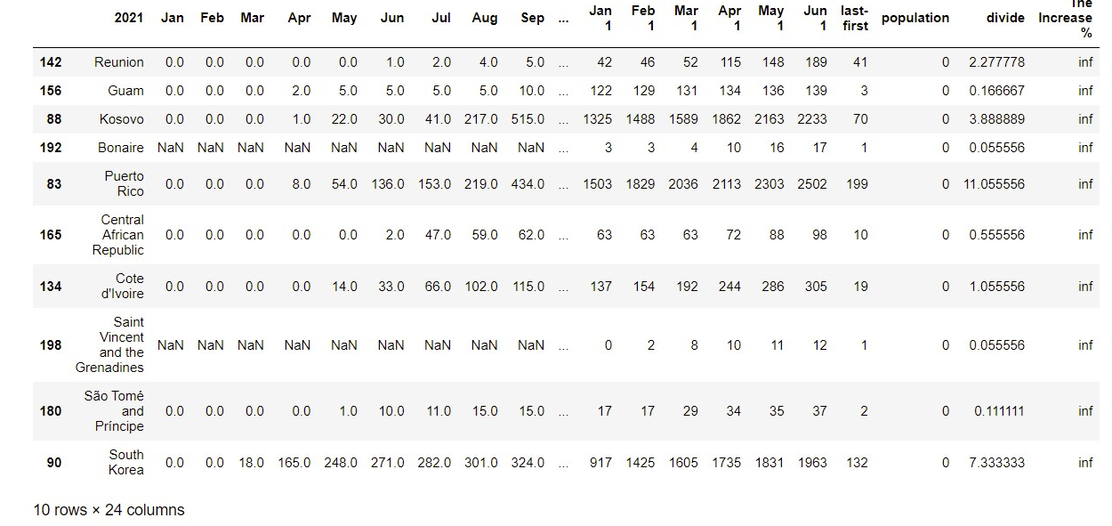
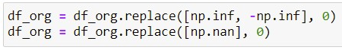
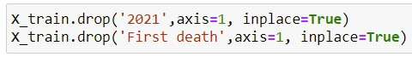
After we doing our math operations there is a lot of data
that we Not need.
Values like inf or 0, so we clean our table.
We drop data that we don’t need to our math operation.

Slide 12

EDA

Slide 13
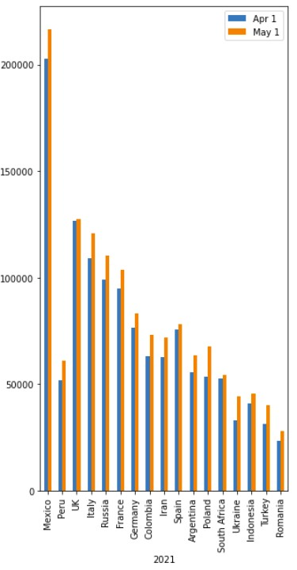
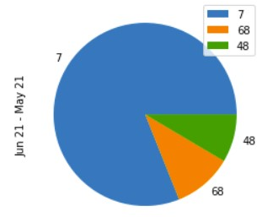
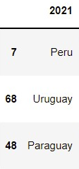
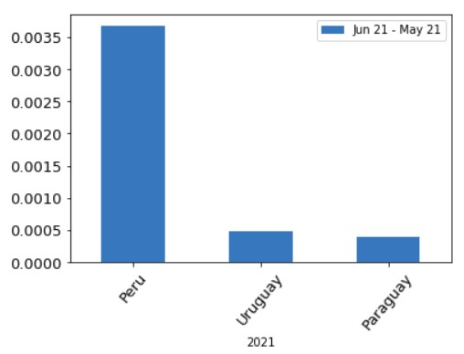
Pie&Bar Plot,
Top 3 countries with the highest deaths in July
Bar Plot,
Top 20 countries with the highest deaths in APRIL and MAY
This countries is the top because we did math operations :
We take the last month that had the number of deaths
we divided it to the population
We had the % of each country, how many deaths there is.

Slide 14
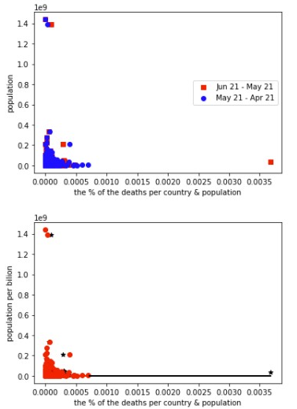
Linear regression
Using the sklearn for linear regression
Basic data set visualization for hints for regression results

Slide 15

Machine Learning

Slide 16

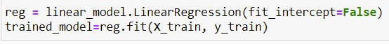
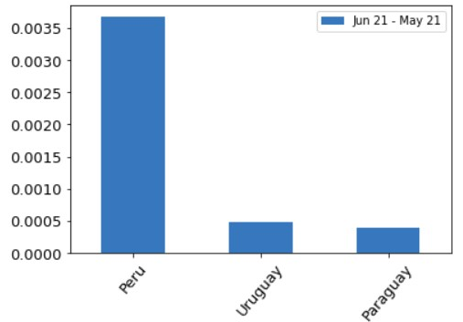
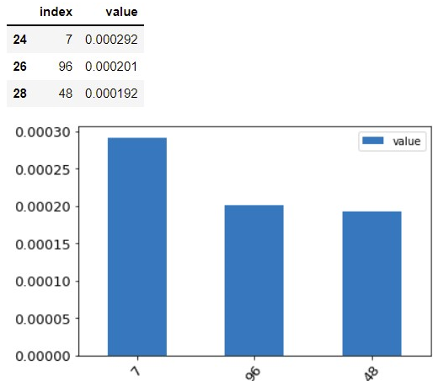
Using library and linear regression we were able to train a model that predicts witch top 3
Countries there will be the large number of deaths with population.
Our project
The predict

